Slide 1
SUBMARINE CABLES FOR AFRICA
Byron Clatterbuck – SEACOM CEO

Slide 2
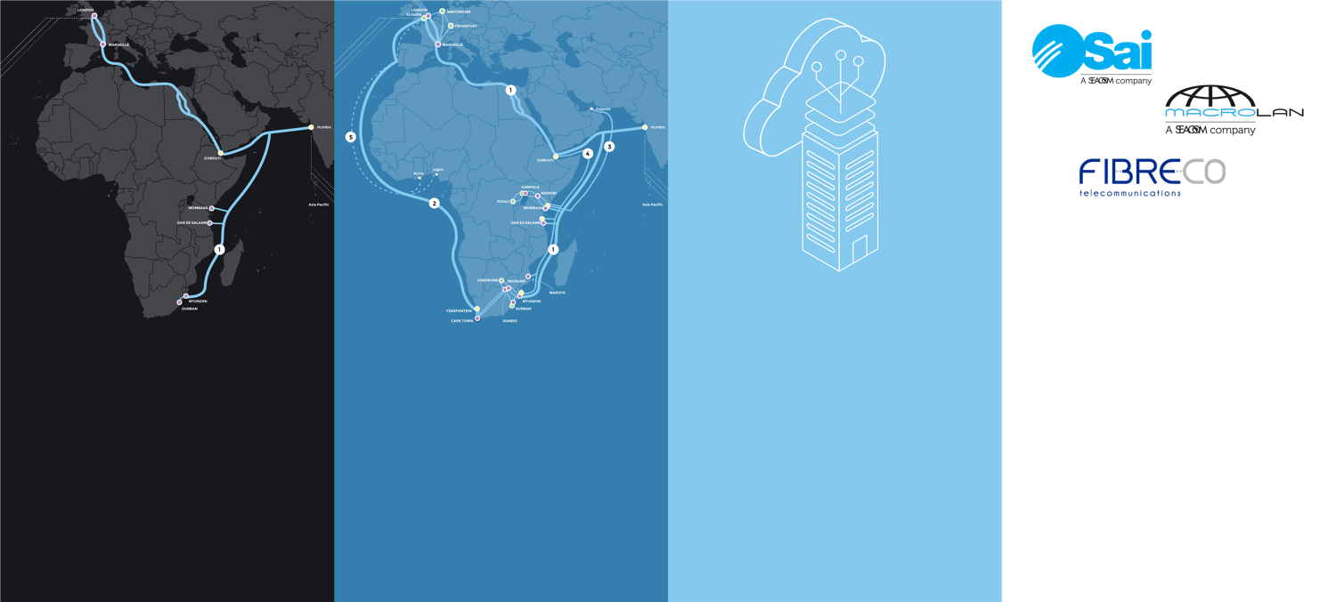
SEACOM TRANSFORMED INTERNET CONNECTIVITY IN AFRICA IN 2009
PAN-AFRICAN
‘19 & beyond: SEACOM - Market Consolidator
‘09: SEACOM at launch
‘12 – ‘14: SEACOM Service Provider
‘14 – ‘18: SEACOM Business
- Privately funded by largely African investors with funds raised in 2007
- System launched in July 2009
- Added 80G of capacity to data-starved markets
- Allowed “open access” to all ISPs, MNO, and regional telcos
Invested in WACs to create “Ring around Africa”
Grew to Africa’s largest meshed IP network
Largest host of OTT & CDN traffic
Largest peering relationships of all African carriers
Carrier neutral cloud platform
Launched expansion into the enterprise market in South Africa and then Kenya
Delivery of scalable bandwidth low latency internet experience to enterprises
Deployment of last mile metro and long-haul terrestrial fibre
Acquisitions to expedite growth
Further investments to drive capacity and network diversity
Targeted acquisitions to expedite growth
Enterprise service expansion in well known markets
Invest in further lit fibre deployment to grow scale

Slide 3


















AFRICAN MARKET TRENDS
Internet penetration up from 16% in 2013 (167m users) to 35% in 2018 (453m users), largely due to mobile and smartphone penetration growth. Fixed-line penetration remains very low.
Key Points
Africa in 2018
Africa in 2025
The African fibre and enterprise ICT market developing like global markets
CDNs and global content owners/operators are moving content and infrastructure to Africa
Smartphone usage grows rapidly, bottlenecks continue to fixed fibre services into the wider market
More core infrastructure is rolled out, regional connectivity is developed, African market usage accelerates
Requirements for diverse and affordable international connectivity increases as Africa is integrated with the digital world
35% Internet penetration
453m Internet users
~50% Internet penetration
600m Internet users
>50% urban residents online
200m smartphones
$300bn Internet GDP contribution
600m smartphones
177m Facebook users
$18bn Internet GDP contribution
$75bn in e-commerce sales
Source: McKinsey, InternetWorldStats, GSMA
Increased staff consumption as well as adoption of Enterprise Services drives an increase in capacity to offices
1Mb/s
5Mb/s
10Mb/s
50Mb/s
1Gb/s
2005
2007
2009
2011
2013
2015
2019+

Slide 4
SOUTH AFRICAN DATA MARKET IS LARGE AND MOVING FROM TRADITIONAL LARGE FIXED-LINE PLAYERS TO DYNAMIC CHALLENGERS
BMI-T Data
Market Today (2018)
Market Forecast (2023)
Products
Internet
ZAR 12.2 Billion
ZAR 14.7 Billion
Internet Access
IP Transit
Other Data
ZAR 13.0 Billion
ZAR 13.8 Billion
MPLS/Ethernet
VPN
Changing nature of competition
Indicative market share shift in SA retail fixed* broadband, 2010 vs. 2018
Last 5 years
Fibre disrupts the market
Aggressive price/ performance shift
Rapid growth in fibre penetration off low base
Today
Pricing stabilised
Services create customer stickiness
Penetration <30% in SME & upper LSM segments
Next 3 years
Further market penetration
Growth will come mainly from next customer tier (lower ARPUs)
Note: *Fixed broadband (DSL, fibre and leased line), business and home markets combined. Retail ISP share (not underlying physicals).

Slide 5
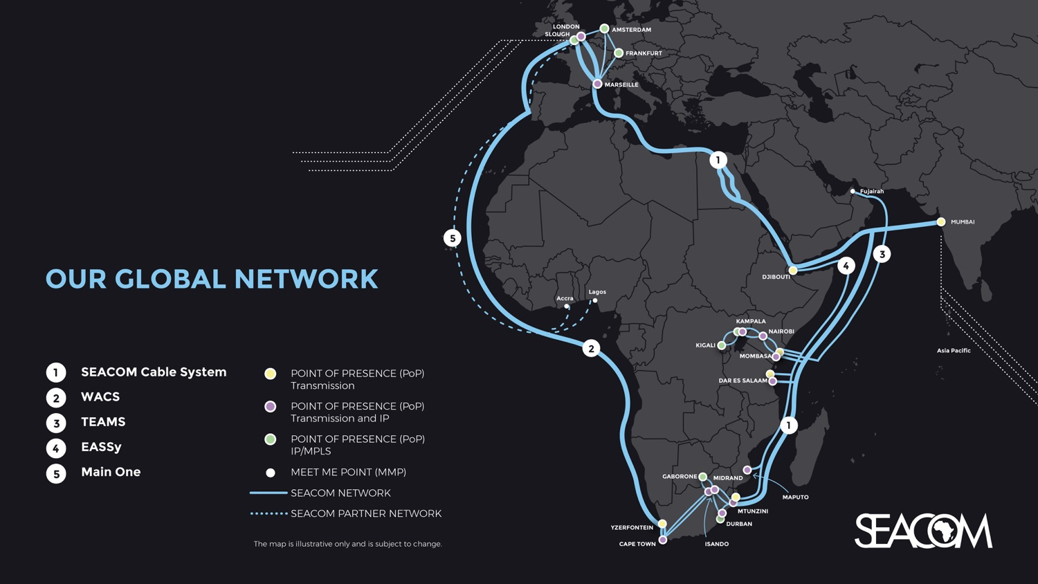
CURRENT KEY SOUTHERN AFRICA
SUBSEA CABLES Existing “Ring around Africa” Three Key High-Speed Subsea Routes Mix of Consortium and Private Builds

Slide 6
SOUTHERN AFRICAN SUBSEA MARKET DYNAMICS
Upgrades continue, with incremental upgrade costs continuing to decline and drive down overall average cost per MB
Most capacity utilized on the “Super Highways” into South Africa, Kenya, and Nigeria
Content and Cloud Service Providers rolling out more infrastructure and investment in Africa
Increase in African regional traffic
Prices for IP Transit at US$3/MB in South Africa for medium volume commit
IRU 10G at under US$1m South Africa to Europe

Slide 7
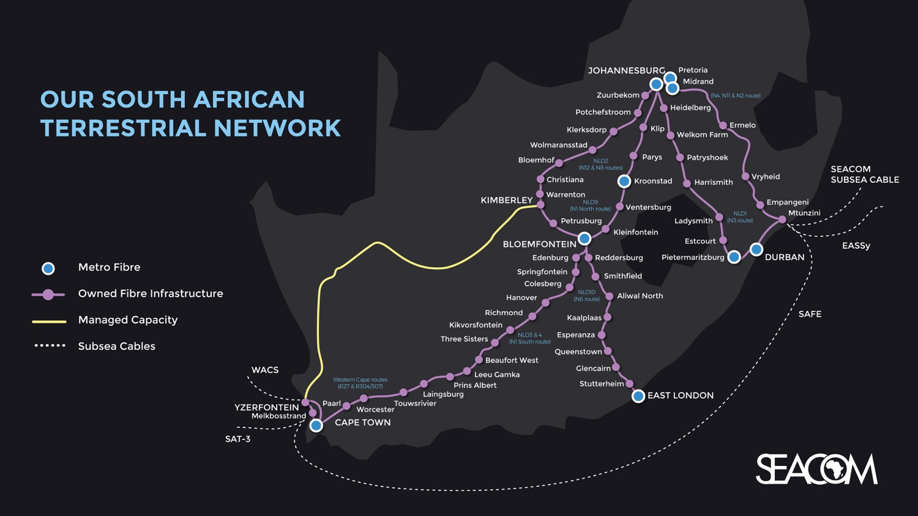
Terrestrial networks key to efficient resiliency
Connect East to West Coasts at high speed and low cost

Slide 8

ISSUES FACING SUBSEA INFRASTRUCTURE IN AFRICA
Cloud demand is increasing
Existing subsea cables are upgrading more frequently, and will reach their ultimate capacity in a few years
Existing cables are ageing
Only three key routes, two on East Coast and one on West
New subsea cables take years to construct, activate and reach the market
Cable investments are highly capital intensive and cost hundreds of millions of US dollars
Terrestrial infrastructure within Africa is still developing

Slide 9
SUBSEA INFRASTRUCTURE INVESTMENT MODELS
Consortium
Lots of investors (carriers, ISPs, MNO, etc)
Lots of bureaucracy
Private
High risk
Highly agile
Hybrids
Shared risk
More agile
Subsea Cable Infrastructure investment is usually a “build vs buy” decision

Slide 10
POTENTIAL NEW AFRICA SUBSEA CABLES
High Fibre Count Open Access Hybrid Models
Equiano
SIMBA

Slide 11
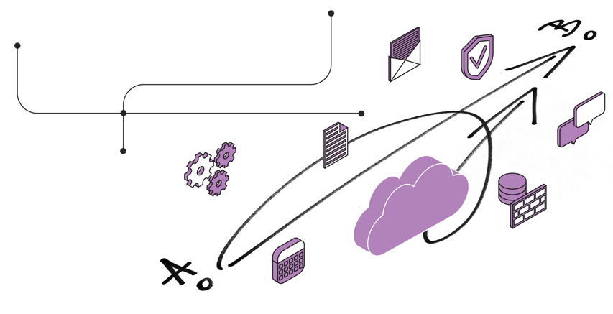
SUMMARY
Huge investment in infrastructure is required to develop Africa’s economies and communications infrastructure
Majority of this is required in domestic terrestrial, cross-border, metro access, radio access, data centers, etc
Subsea infrastructure is a very small part of what is required
More capacity and more diverse routing in subsea infrastructure is needed, and can kick start other investments
“Cross Africa” network rings need to develop (along with highways and railways)

Slide 12
THANK YOU

